Slide 1
WIA1005 Network Technology Foundation
Chapter 7
Application Layer

Slide 2
Contents
Introduction
Network Services
Small Network
Troubleshooting

Slide 3
Introduction
The application layer is closest to the end user. The layer that provides the interface between the applications we use to communicate and the underlying network over which our messages are transmitted.
Application layer protocols are used to exchange data between programs running on the source and destination hosts.
Some of the most widely known application layer protocols include Hypertext Transfer Protocol (HTTP), File Transfer Protocol (FTP), Trivial File Transfer Protocol (TFTP), Internet Message Access Protocol (IMAP), and Domain Name System (DNS) protocol.

Slide 4
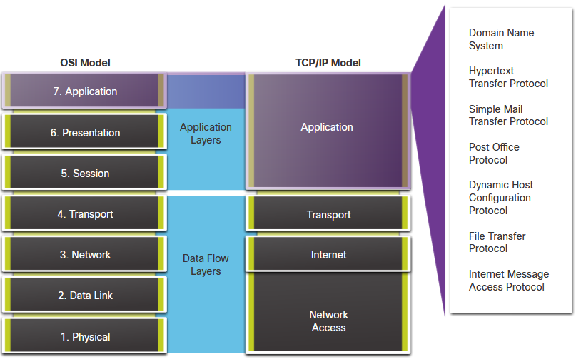
Introduction

Slide 5
Introduction
The presentation layer has three primary functions:
  Formats, or presents, data from the source device into a compatible form for receipt by the destination device.
  Compression of the data in a way that can be decompressed by the destination device.
  Encryption of the data for transmission and the decryption of data upon receipt by the destination.
Example, some well-known standards for video include Matroska Video (MKV), Motion Picture Experts Group (MPG), and QuickTime Video (MOV).

Slide 6
Introduction
The session layer create and maintain dialogs between source and destination applications.
The session layer handles the exchange of information to initiate dialogs, keep them active, and to restart sessions that are disrupted or idle for a long period of time.

Slide 7
Network Services
Hypertext Transfer Protocol (HTTP)
  Protocols that are designed for common uses such as web browsing and email.
  When a web address or Uniform Resource Locator (URL) is typed into a web browser, the web browser establishes a connection to the web service.
  HTTP is a request/response protocol.
  The three common message types are GET, POST (form data), and PUT (upload).
  For secure communication across the Internet, the HTTP Secure (HTTPS) protocol is used. HTTPS uses authentication and encryption to secure data as it travels between the client and server.

Slide 8
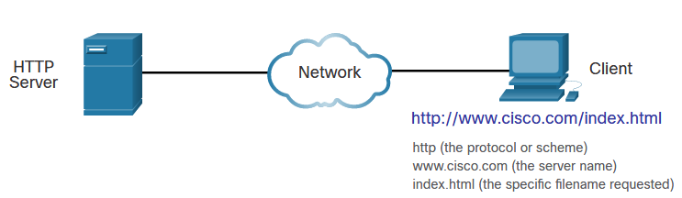
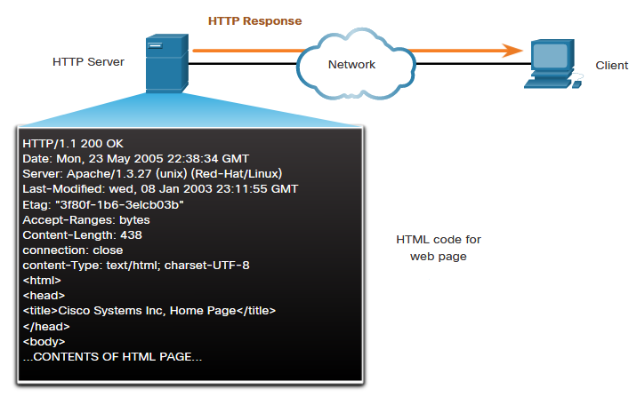
Network Services

Slide 9
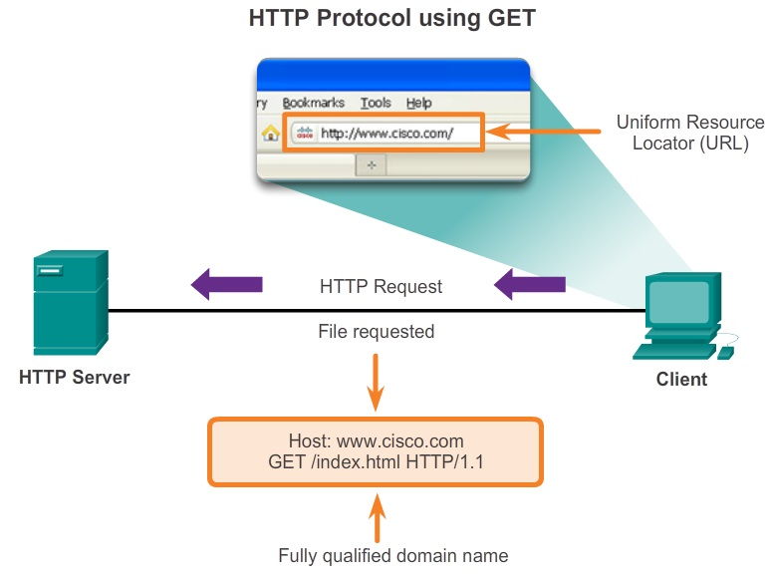
Network Services

Slide 10
Network Services
Email is a store-and-forward method of sending, storing, and retrieving electronic messages across a network. Email messages are stored in databases on mail servers.
Email clients communicate with mail servers to send and receive email. Mail servers communicate with other mail servers to transport messages from one domain to another.
Email supports three separate protocols for operation: Simple Mail Transfer Protocol (SMTP), Post Office Protocol (POP), and Internet Message Access Protocol (IMAP).

Slide 11
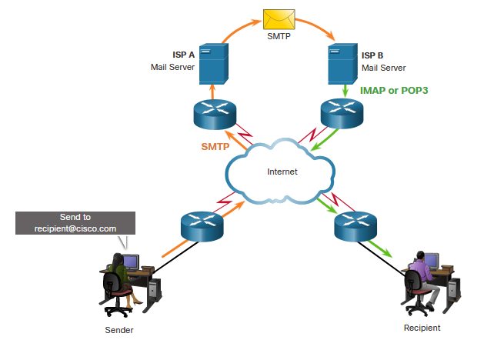
Network Services

Slide 12
Network Services
Simple Mail Transfer Protocol (SMTP) transfers mail reliably and efficiently. SMTP message formats require a message header and a message body. When a client sends email, the client SMTP process connects with a server SMTP process on well-known port 25.
Post Office Protocol (POP) enables a workstation to retrieve mail from a mail server. With POP, mail is downloaded from the server to the client and then deleted on the server. The server starts the POP service by passively listening on TCP port 110 for client connection requests.

Slide 13
Network Services
Internet Message Access Protocol (IMAP) is another protocol that describes a method to retrieve email messages. However, unlike POP, when the user connects to an IMAP-capable server, copies of the messages are downloaded to the client application.
The original messages are kept on the server until manually deleted. Users view copies of the messages in their email client software.

Slide 14
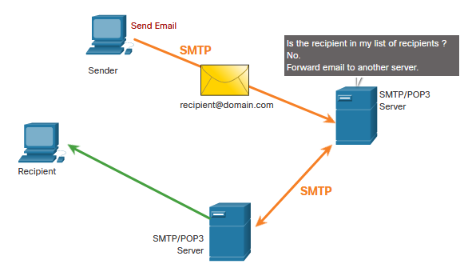
Network Services

Slide 15
Network Services
Domain names were created to convert the numeric IP address into a simple, recognizable name.
On the internet, fully-qualified domain names (FQDNs), such as http://www.cisco.com, are much easier for people to remember than 198.133.219.25, which is the actual numeric address for this server.
The DNS protocol defines an automated service that matches resource names with the required numeric network address. It includes the format for queries, responses, and data.

Slide 16
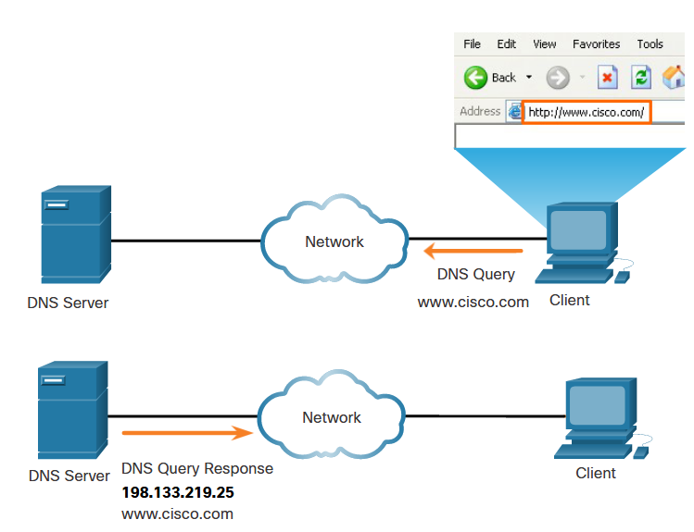
Network Services
The Domain Name System (DNS) was created for domain name to address resolution for these networks. DNS uses a distributed set of servers to resolve the names associated with these numbered addresses

Slide 17
Network Services
A DNS server provides the name resolution using the Berkeley Internet Name Domain (BIND)
The DNS server stores different types of resource records used to resolve names. These records contain the name, address, and type of record.
  A - An end device IPv4 address
  AAAA - An end device IPv6 address
  NS - An authoritative name server
  CNAME - Fully Qualified Domain Name
  MX - Mail exchange record; maps a domain name to a list of mail exchange servers for that domain

Slide 18
Network Services
When a client makes a query, the server DNS process first looks at its own records to resolve the name. If it is unable to resolve the name by using its stored records, it contacts other servers to resolve the name.
The DNS cient service on Windows PCs also stores previously resolved names in memory. The ipconfig /displaydns command displays all of the cached DNS entries.
The DNS protocol uses a hierarchical system to create a database to provide name resolution. The naming structure is broken down into small, manageable zones.

Slide 19
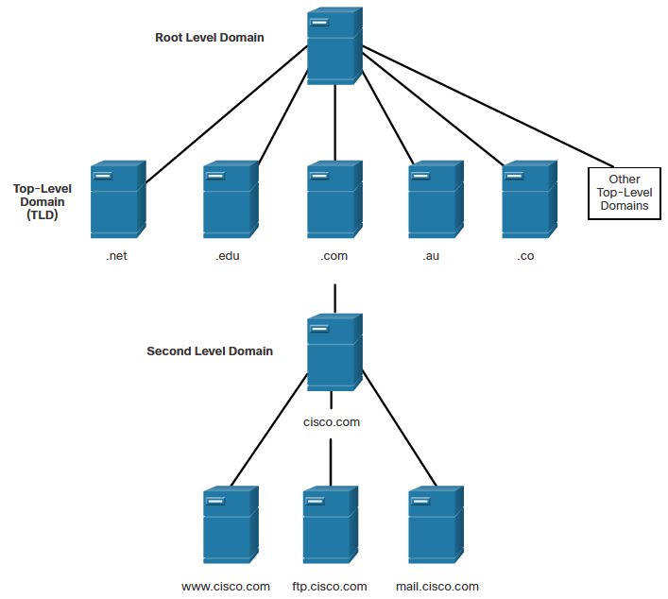
Network Services

Slide 20
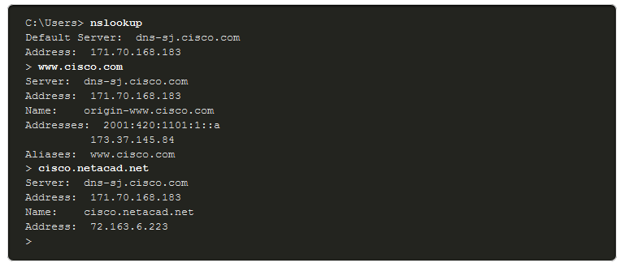
Network Services
nslookup command allows the user to manually query the name servers to resolve a given host name. This utility can also be used to troubleshoot name resolution issues and to verify the current status of the name servers.

Slide 21
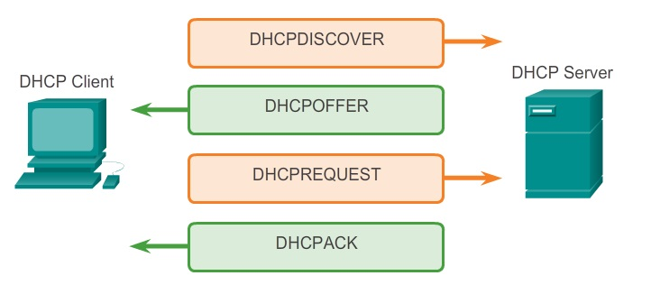
Network Services
The Dynamic Host Configuration Protocol (DHCP) service enables devices on a network to obtain IP addresses and other information from a DHCP server.
This service automates the assignment of IP addresses, subnet masks, gateway, and other IP networking parameters.

Slide 22
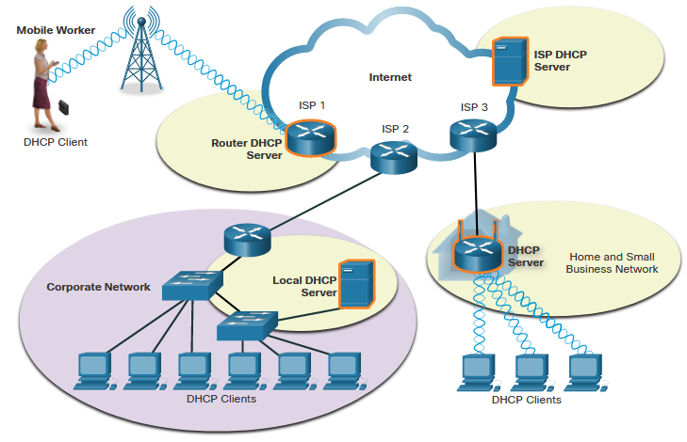
Network Services

Slide 23
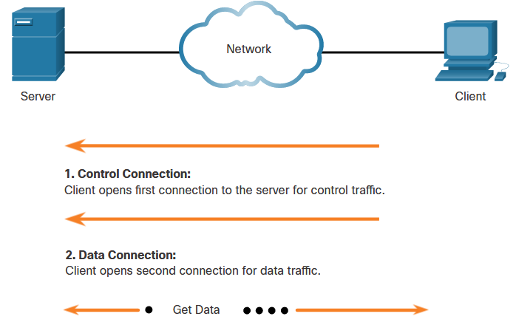
Network Services
The File Transfer Protocol (FTP) is another commonly used application layer protocol. FTP was developed to allow for data transfers between a client and a server.
An FTP client is an application which runs on a computer that is being used to push and pull data from an FTP server.

Slide 24
Network Services
The client establishes the first connection to the server for control traffic using TCP port 21. The traffic consists of client commands and server replies.
The client establishes the second connection to the server for the actual data transfer using TCP port 20. This connection is created every time there is data to be transferred.
The data transfer can happen in either direction. The client can download (pull) data from the server, or the client can upload (push) data to the server.

Slide 25
Network Services
The Server Message Block (SMB) is a client/server file sharing protocol to describe the structure of shared network resources, such as directories, files, printers, and serial ports. It is a request-response protocol.
All SMB messages share a common format. This format uses a fixed-sized header, followed by a variable-sized parameter and data component.
SMB messages can:
  Start, authenticate, and terminate sessions
  Control file and printer access
  Allow an application to send or receive messages to or from another device

Slide 26
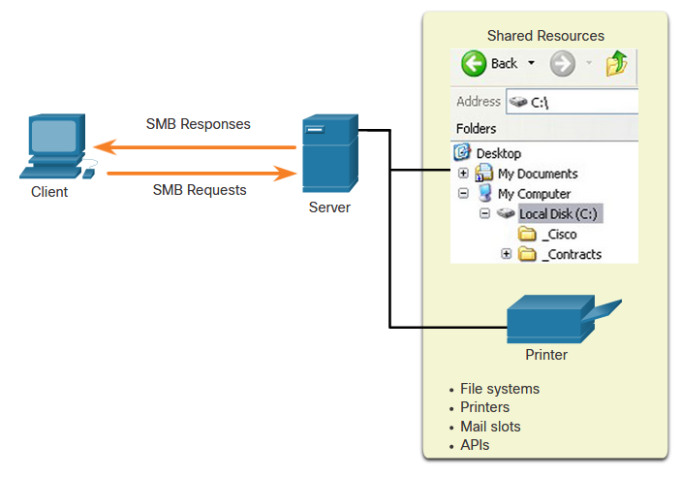
Network Services

Slide 27
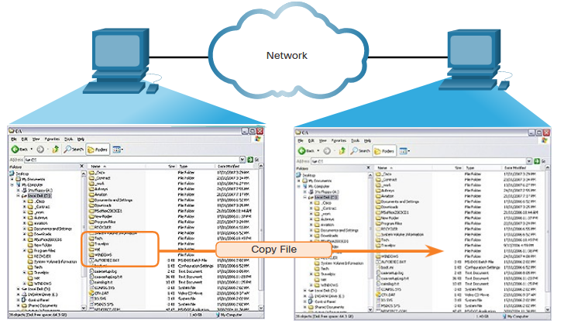
Network Services

Slide 28
Network Services
Unlike FTP, clients establish a long-term connection to servers. After the connection is established, the user of the client can access the resources on the server as though the resource is local to the client host.
The LINUX and UNIX operating systems also provide a method of sharing resources with Microsoft networks by using a version of SMB called SAMBA.
The Apple Macintosh operating systems also support resource sharing by using the SMB protocol.

